Slide 1


CNCF COIMBATORE MEETUP
Scaling without Limits
The Serverless way
21-Sep-2024

Slide 2
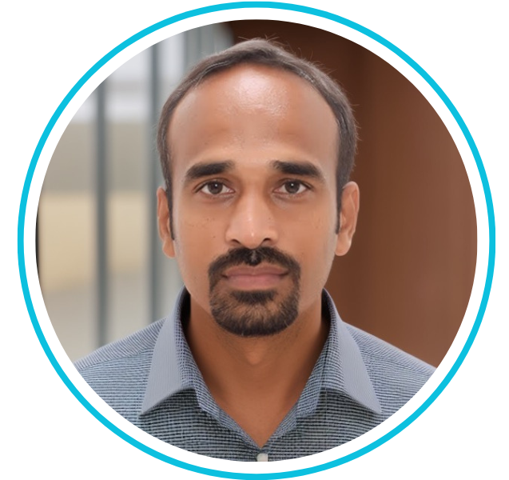

ABOUT ME
Sivasubramanian Bagavathiappan (Siva)
Senior Architect & SRE Leader
19
2
Years of Experience
Patents Filed

Slide 3
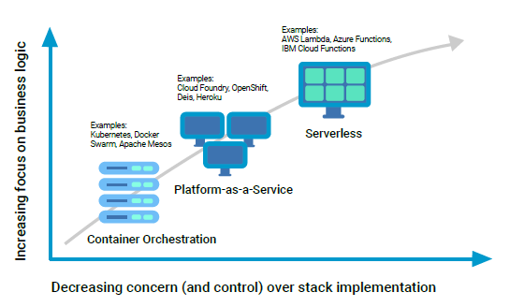
WHAT IS SERVERLESS?
Source: CNCF WG-Serverless Whitepaper 1.0

Slide 4







KEY CHARACTERISTICS
Zero Server Management
Event Driven
Autoscaling
$
Pay per usage
Cold Start

Slide 5

WHAT’S NOT SERVERLESS?
IaaS in Cloud & Self hosted/managed datacenter
PaaS with limited or no auto scaling capabilities
Container orchestration platform where still platform management is still needed
Cloud services such as Blob storage, Database as a Service (DBaaS)

Slide 6
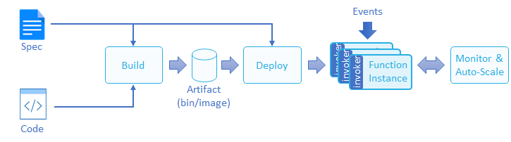
FUNCTION LIFECYCLE
Source: CNCF WG-Serverless Whitepaper 1.0

Slide 7
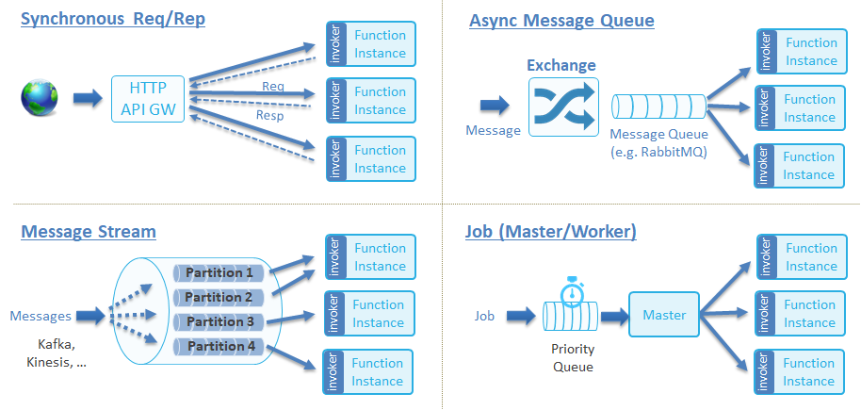
FUNCTION INVOCATION TYPES
Source: CNCF WG-Serverless Whitepaper 1.0

Slide 8
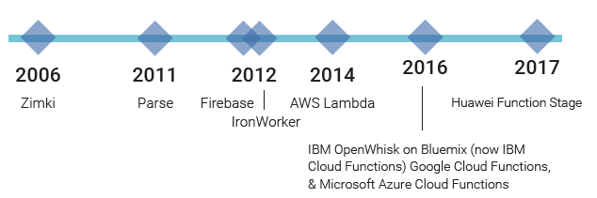
INTERESTING FACTS
1st Serverless platform traced back to 2006
Adoption Rate in public cloud
Potential cloud cost savings
60%
Zimki
50%
70% AWS customers
60% GCP customers
49% Azure customers
Source: datadoghq.com
80% Only serverless
50% Multi-service architecture
20% Beginners
Source: techdogs.com

Slide 9
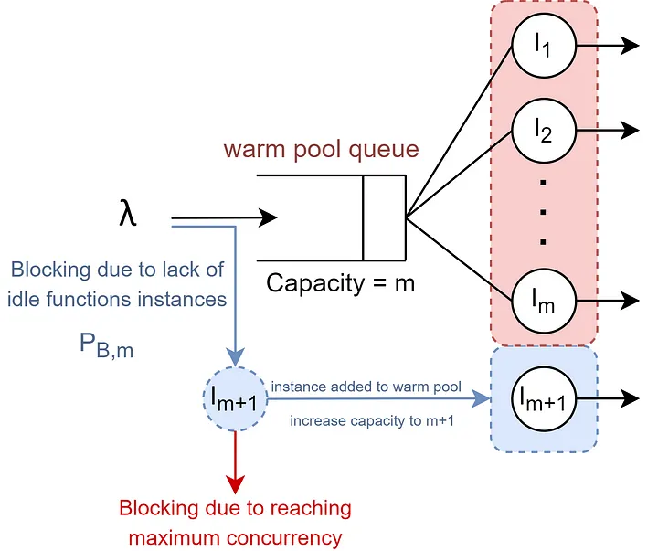
SCALING WITH SERVERLESS
Scale-Per-Request
Source: LinkedIn blog by Saral Saxena

Slide 10
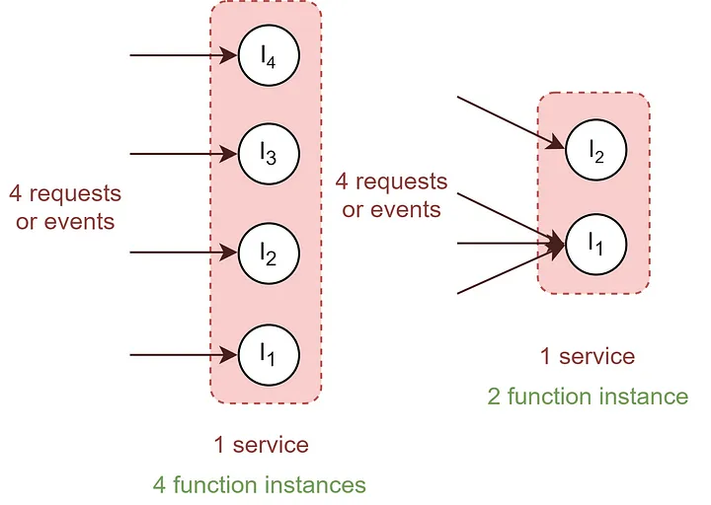
SCALING WITH SERVERLESS
Concurrency Value based
Source: LinkedIn blog by Saral Saxena

Slide 11






SCALING WITH SERVERLESS
Metric based
Resource Utilization
(CPU, Memory, Disk)
Throughput, latency or Queue depth
Custom metric (Viewership count, Checkouts etc.)
Predictive Analytics based on ML models
Schedule or Trigger

Slide 12








Best Practices for Development
Keep it small to perform simple focused task
Use external storage to maintain state
?
Optimize the code for quick start and performant
Consider batch for large workloads
Robust Auth-N, Auth-Z with necessary resource privilege
M.E.L.T with alerts for quicker issue isolation
Automated CI/CD with proper validations and quality gates
Cost optimization by optimize resource usage

Slide 13



How to overcome COLD START challenge?
Provisioned Concurrency
Pre-warming
Scheduled pre-scaling
Code Optimization

Slide 14




USE CASES
Real-time data processing
Signals from IoT devices, social feed, stock market updates etc.
Event driven pipelines
API / Microservices
RESTFul APIs
API Gateway or Router
Static / Dynamic Web apps
Machine Learning
Train ML Models on large dataset
Deploy trained model for real-time actions
Custom Integrations
3rd party service integrations
Automate workflows and tasks

Slide 15




ANTIPATTERNS
High resource intensive workloads
Complex or compute intensive tasks
Long-running processes
State management & Dependencies
Avoid using global variables to store state
Complex dependencies
Overlooking Security
Vulnerable if input is not properly validated and secured
Strict Performance & Cost requirement
High volume and low latency workload
Legacy systems

Slide 16






OBSERVABILITY
Metrics
Latency, traffic, Errors, Saturation, throttling
Events
Startup, Scale-up, scale-down, deployment
Logs
Failures, Exceptions, state transformation
Traces
Spans, attributes
Profiling Data
CPU sampling, Memory allocations

Slide 17
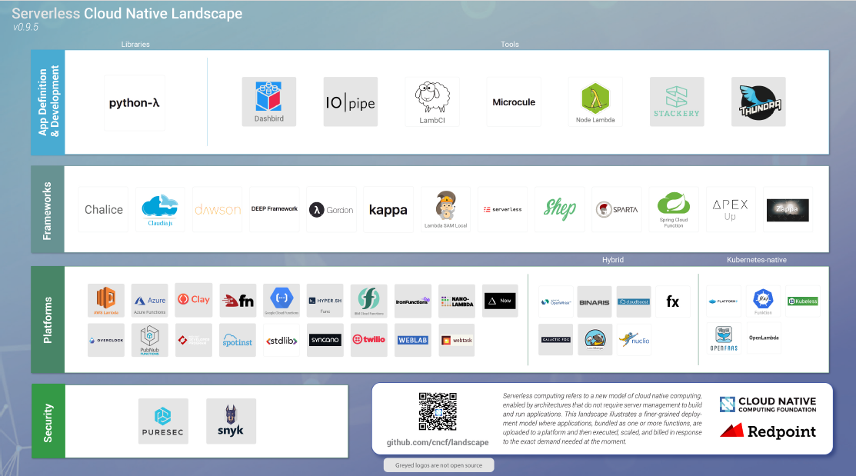
CNCF’s Place in Serverless ecosystem

Slide 18
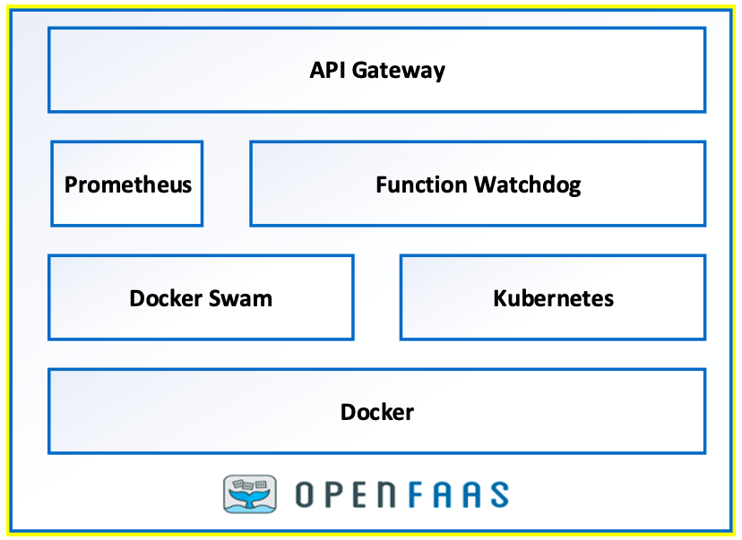
OpenFaaS

Slide 19

Demo

Slide 20
CONCLUSION
Flexibility and customization in building scalable and event-driven applications.
Cost-effectiveness through pay-per-use-model and eliminates infrastructure management overhead
Scalability
Broader community support & vendor independence on using open source CNCF frameworks.
Growing opportunity & maturity
Integration with edge computing
Hybrid or multi-cloud support
Improved developer experience

Slide 21




Thanks!
Want to connect?
kbsivacse@live.com

